Slide 1
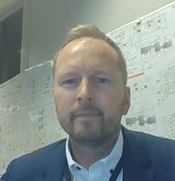
Ståle Endre Berg holds a MSc in Finance from Carlson School of Mgmt, University of Minnesota, US.
He held various trading/trading manager roles in Norsk Hydro from 1997 – 2007.
Joined StatoilHydro, now Equinor, through the merger in 2007 as VP Products Trading.
He held various VP and SVP roles in the downstream area, latest being Global head of crude trading and refining optimization based in London 2014 – 2018.
Took on the first upstream role as VP Operations Troll 2018 – 2021. Was appointed SVP Corporate Safety in June 2021 in a newly formed corporate SSU function, covering across Safety, Security, Sustainability and Management System and Assurance.
Personal commitment on safety:
“I make sure that safety has the number one priority in all encounters with colleagues and stakeholders.
I ask for and discuss safety perspective in all our projects and deliveries.
I promote our safety focus with my internal and external stakeholders and partners.”

