Slide 2
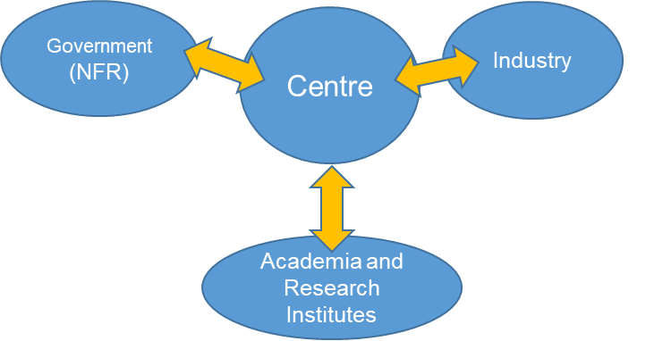
Petro centre
A publicly and private funded research centre
User partners
Research partners
RCN
Long term, industry focused research
Public funding for up to eight years
Academic partners
National
International

Slide 3
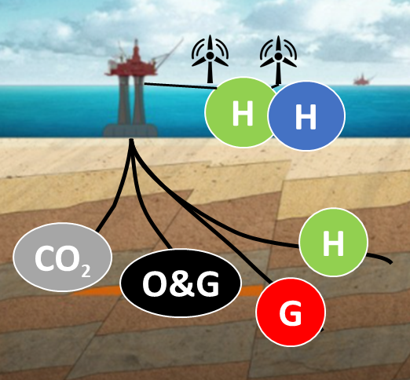
The vision of the NCS2030 centre is to facilitate an energy-efficient, multi-purpose utilization of the subsurface of the NCS into a “Sustainable Subsurface Value Chain”
Subsurface Energy Systems
Education
Outreach
Sustainable Subsurface
Value Chain
Net-zero emission production
Society
Collaboration
Innovation
Digitalization

Slide 13
Acknowledgement
The author(s) acknowledge the Research Council of Norway and the industry partners of NCS2030 – RCN project number 331644 – for their support.

Slide 14
User partners & observers

